Slide 1

Neural Network
Teoh Teik Toe
ITOM/NBS
ttteoh@ntu.edu.sg
97905202

Slide 2
Reading before class
https://youtu.be/bfmFfD2RIcg
https://youtu.be/aircAruvnKk
Drive:
Code: https://drive.google.com/drive/folders/1fXjR7HWQVDvW4b_UwFmEM_NymlOo4Wbw?usp=sharing
Data: https://drive.google.com/drive/folders/1DWSSkL9zMwXktar8rxC_3rUGqxwNNTrR?usp=sharing

Slide 3
Agenda
Neural Network Theory
What is Neural Network and the metrics
Types of regression
Application & Interview Question
Advantages & Disadvantages & Comparison & Limitation
Programming & Keras Programming
Example
Exam Result
Equity
Treynor

Slide 4
Part I Neural Network Theory

Slide 5

Neural Network
To model how the human brain “thinks”
Neurons are connected by synapses to receive and pass signals.

Slide 6
Perceptron Example
2
.5
1
.3
=-1
2(0.5) + 1(0.3) + -1 = 0.3
Learning Procedure:
Randomly assign weights (between 0-1)
Present inputs from training data
Get output O, measure the difference, adjust weights
Repeat; stop when no errors, or enough epochs completed

Slide 7
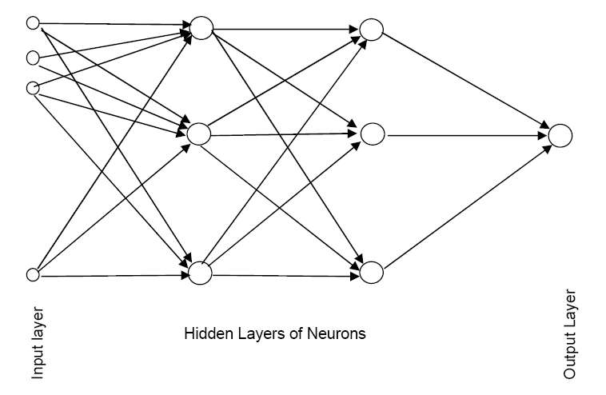
Schematic Diagram (with 2 hidden layers)

Slide 8
Neural Network
Multiple layers
Input layer (raw observations) [only 1]
Hidden layer(s) to process observations [Minimum 1]
Output layer for final prediction [only 1]
Nodes within layers act as neurons.
Weights (aka coefficients) connect neurons in one layer to neurons in next layer.

Slide 9
Neural Network
Completion of all rows of data through the network is one epoch (also called sweep or iteration)
Set “Learning Rate”
High value reduce number of steps but risk flip flopping and cannot get close enough to the minimum error point.
Low value avoid flip flopping risk (default: 0.01) but increase number of steps necessary to reach minimum error point.

Slide 10
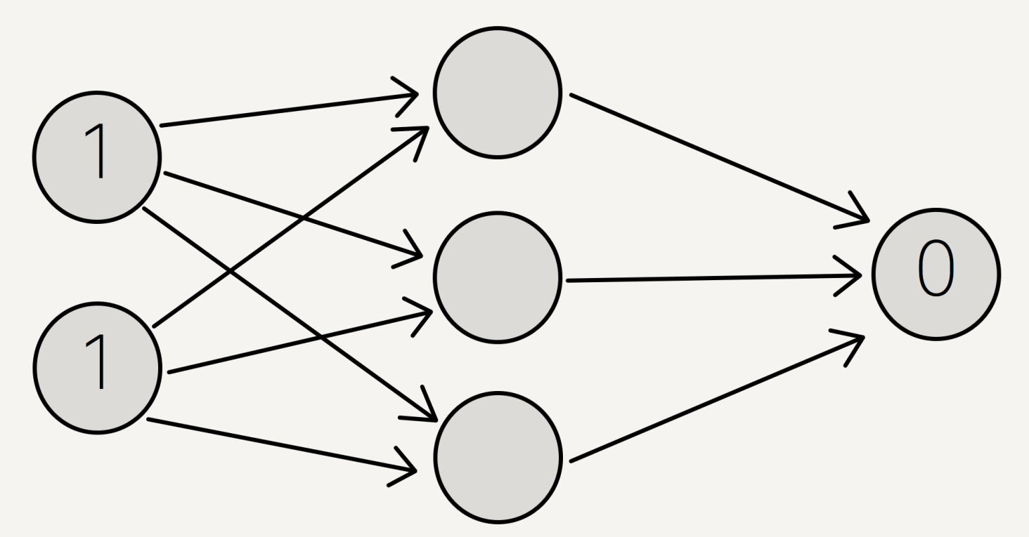
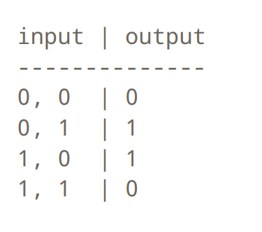
Business Example: Company Borrowing
Input 1: Size: Small=0, Big=1
Input 2: Sales: Low=0, High =1
Output : Borrowing: 0,1
Scenario:
Small Size Company and Low Sales will not borrow money - 0,0 | 0
Big Size Company and High Sales do not need to borrow money - 1,1 | 0
The rest need to borrow money
Size, Sales | Borrow
Take 1,1 | 0 for example

Slide 11
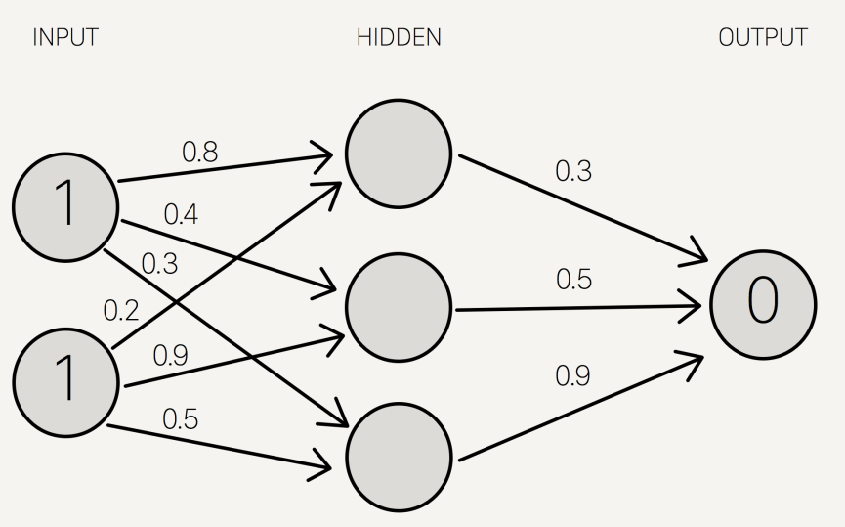
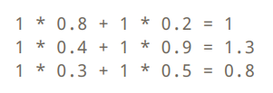
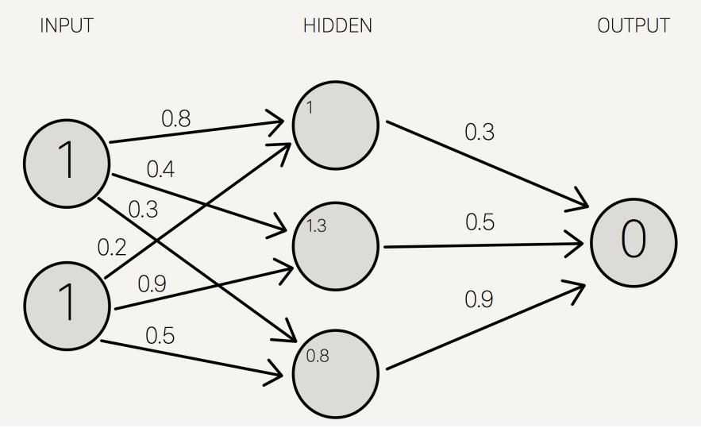
Assign Initial Random Number 0 to1
Step 1 Multiply and Summation
Note: 3

Slide 12
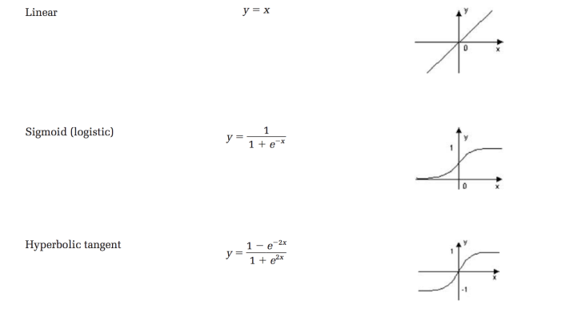
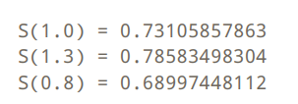
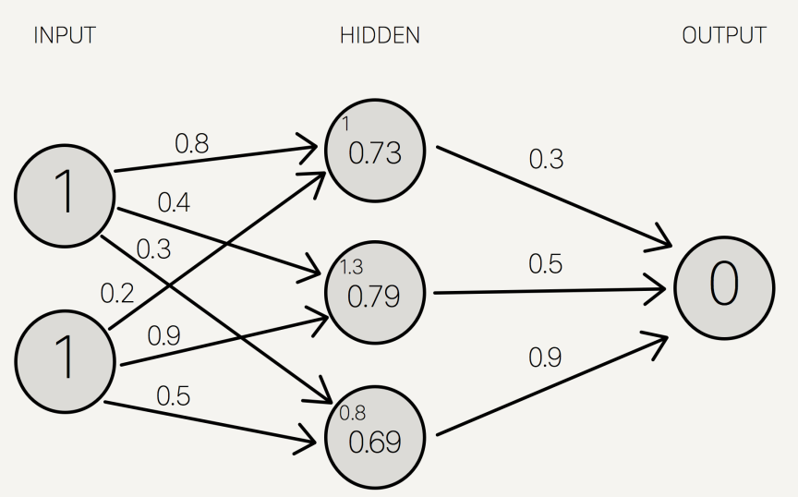
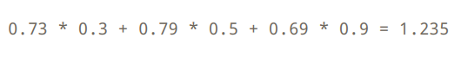
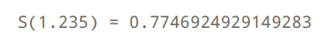
Activation Function
Step 2 Sigmoid Activation
1/(1+e^-1)=0.731
Note: 2
Step 3 Multiply and Summation
Step 4 Sigmoid
Note: 1

Slide 13
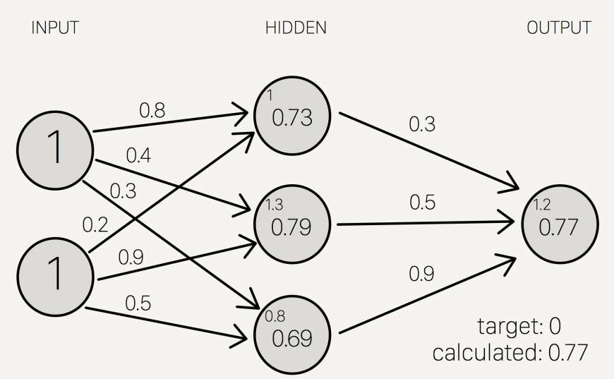
Final Results 0.77 but desired outcome is 0

Slide 14
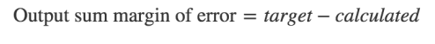
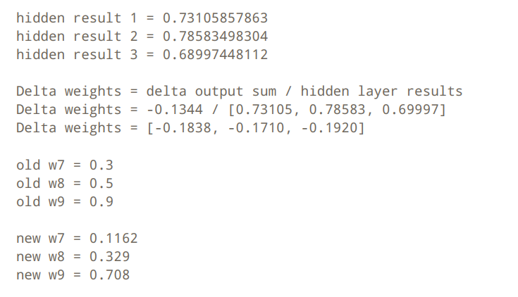
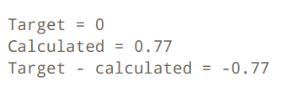
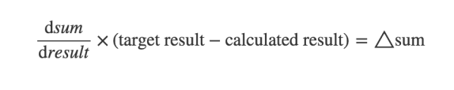
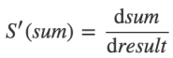
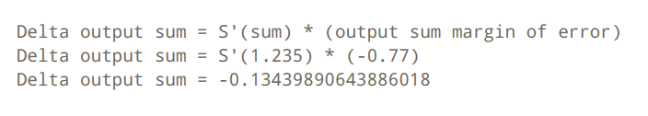
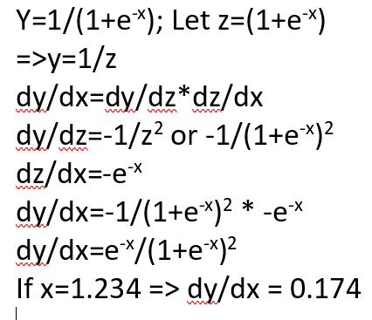
Backward Propagation – Change the weight (optional)
Step 3 Change the weight
Step 1 Margin of Error
Slide 119 Note: 2
From previous sum before activation function
-0.1344/0.734105=-0.1838
1.235 Slide 119 Note: 1
0.3-0.1838=0.1162
Step 2 Delta
S’ Function
0.174*(-0.77)=-0.13439

Slide 15
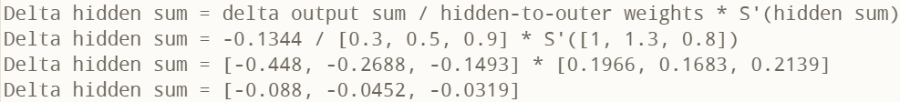
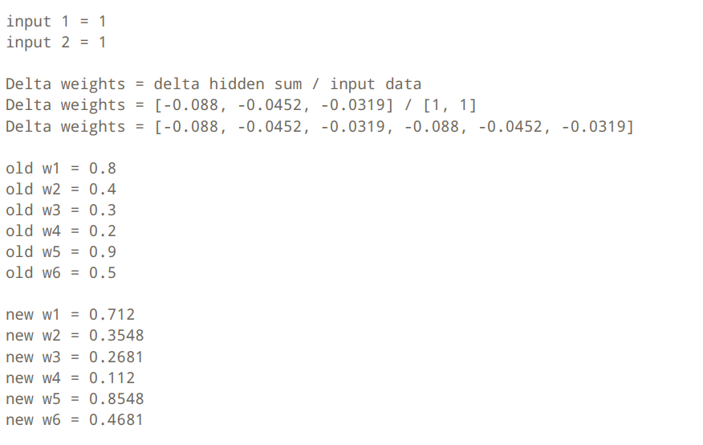
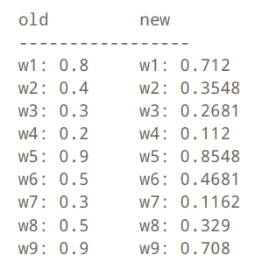
Hidden Layer Weight (optional)
Slide 118, Note: 3
Step 4 Delta
Step 5 Change the weight
-0.1344/0.3=-0.448
0.8-0.088=0.712

Slide 16
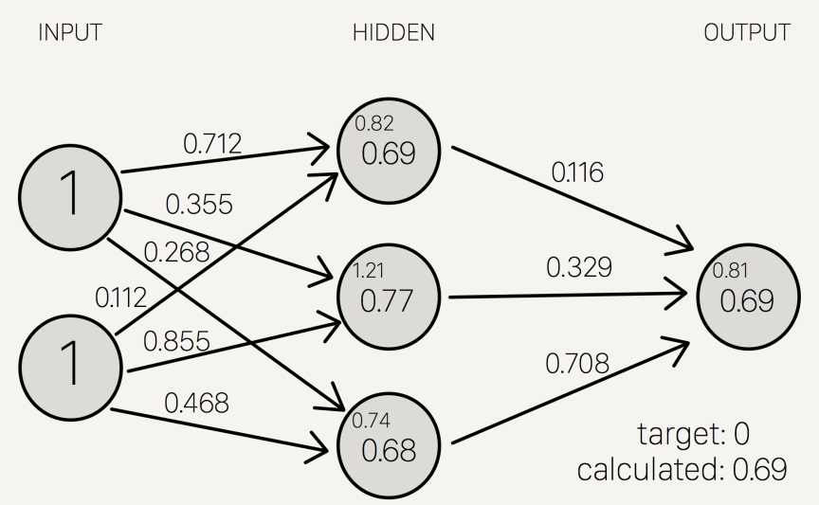
Next Iteration : Error Drop from 0.77 to 0.69
Backward Propagation

Slide 17
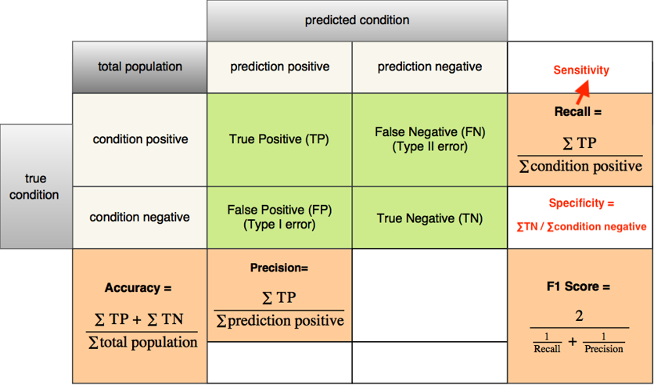
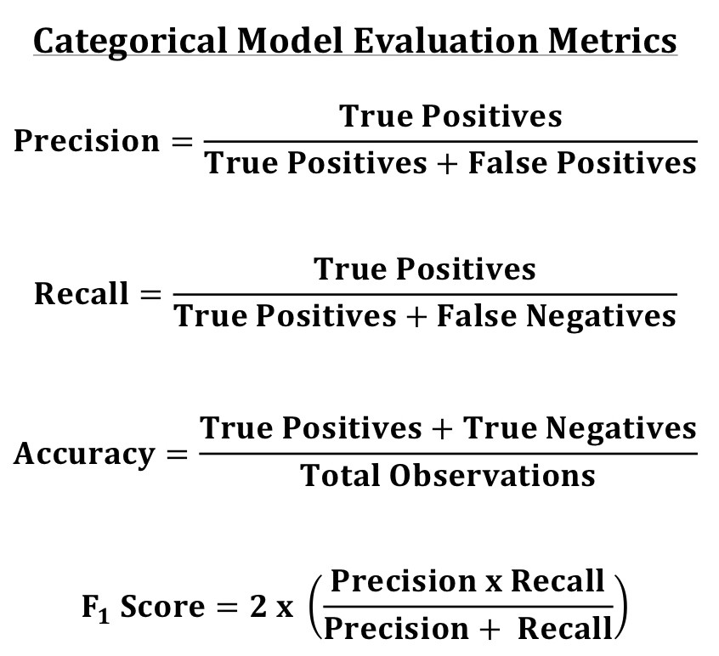
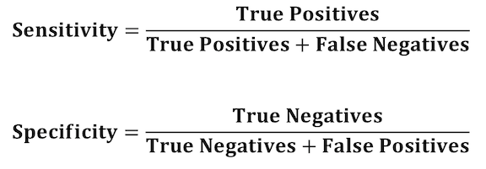
Categorical - Metrics

Slide 18
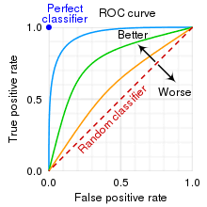
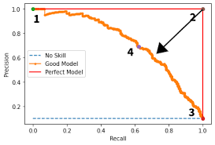
Metrics (Graph) – Determine Threshold
from sklearn.metrics import plot_roc_curve
plot_roc_curve(model,X_test,Y_test)
from sklearn.metrics import plot_precision_recall_curve
plot_precision_recall_curve(model,X_test,Y_test)
When you force the false negative to go down, the speed of increasing false positive?? VV

Slide 19

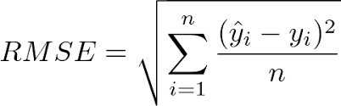
Continuous metrics - RMSE
5 types of error:
Error
Square Error
Sum of Square Error
Mean Square Error
Root Mean Square Error

Slide 20
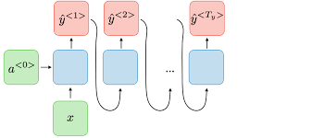

Types of Neural Network
RNN (LSTM & GRU)
CNN

Slide 21
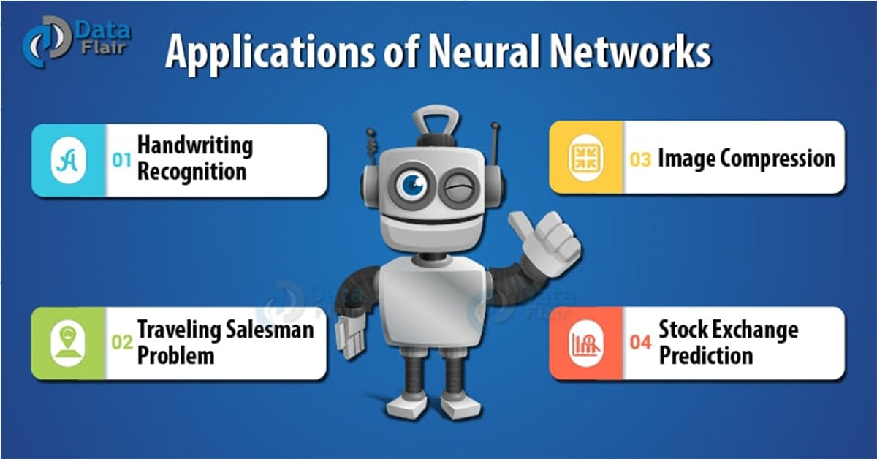
Application of Neural Network

Slide 22
Interview Questions
What is Deep Learning?
What is a Neural Network?
What Is a Multi-layer Perceptron(MLP)?
What Is Data Normalization, and Why Do We Need It?
What is the Boltzmann Machine?
What Is the Role of Activation Functions in a Neural Network?

Slide 23

Advantages of Neural Network
Very low predictive error (on trainset!).
Can capture complex relationships by increasing number of hidden nodes and/or hidden layers.
No need to specify a relationship between Y and Xs.

Slide 24

Disadvantages of Neural Network
Considered a “black box” prediction machine, with no insight into relationships between inputs and outcome
Heavy computational requirements if there are many variables and many hidden layers

Slide 25
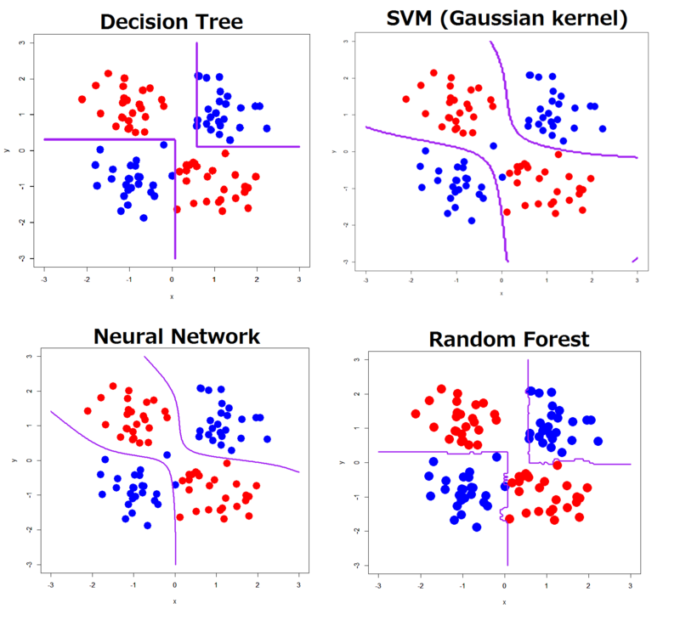
Comparison : Decision Tree vs Neural Network

Slide 26
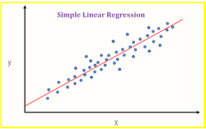
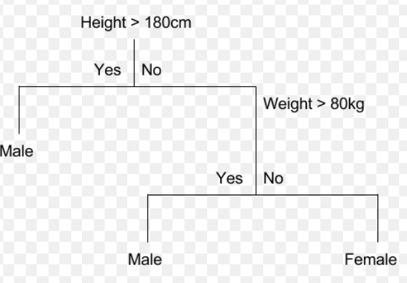
Comparison Regression, Decision Tree and Neural Network
$$y=b_{0}+{b_{1}x}_{1}+b_{2}x_{2}+…+b_{m}x_{m}+e$$
Parameter
Y: gender X1: Height X2: Weight
X1: Height
w.
Y: Gender
X2: Weight
.w

Slide 27
Part II Programming

Slide 28
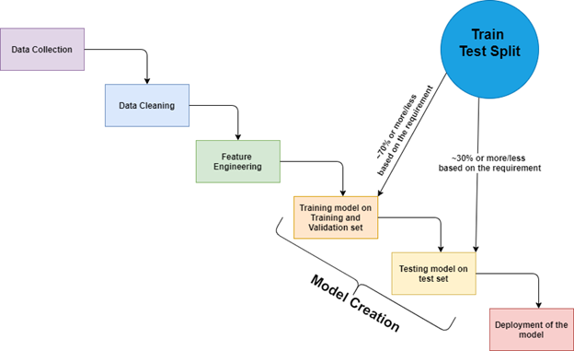
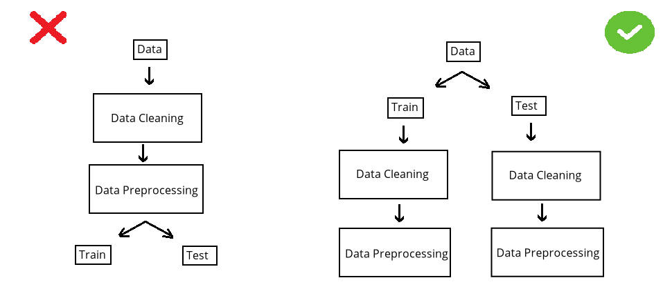

Slide 29
Machine Learning Process
Import data
Decide on Target/Y/Dependent Variable
Check null (imputation?) – May need to check correlation before check null
df.isnull().any() and df["Revenue"].isnull().sum()
If needed, pd.set_option("display.max_rows", 10)
If you have categorical and continuous X, need to do dummy first so that you can use for loop.
#imputation ??
df.isnull().sum()/len(df)
m = df["10Y Net Income Growth (per Share)"].mean()
df["10Y Net Income Growth (per Share)"].fillna(m,inplace=True)
for i in df.columns:
m = df[i].mean()
df[i].fillna(m,inplace=True)
#or using model
pip install miceforest
import miceforest as mf
k = mf.ImputationKernel(df,datasets=1,random_state=1)
k.mice(10) #10 interation
df = k.complete_data(0)
#for categorical
from sklearn.preprocessing import Imputer
imp = Imputer(strategy='most_frequent')
imp.fit(df)
Or
imp = Imputer(strategy=‘constant’,fill_value=“missing)

Slide 30
Machine Learning Process
4. Select features – if not many features, take all. If clean, use Kbest, else use correlation
Kbest – Need to split X,Y
X = df.drop(columns="Creditability")
Y = df["Creditability"]
from sklearn.feature_selection import SelectKBest, f_regression
f = SelectKBest(score_func=f_regression, k=10).fit(X,Y).get_support()
X.columns[f]
df = df.loc[:, ["Creditability", 'Account Balance', 'Duration of Credit Mths',
'Payment Status of Previous Credit', 'Credit Amount’]]
2. Correlaton
pd.set_option("max_rows", None)
c = df.corr()
c = abs(c["fund_treynor_ratio_5years"])
c[c>0.2].sort_values()
df["sector_technology"].isnull().sum() #check if selected columns many nulls
pd.set_option("max_rows", 10)
from sklearn.decomposition import PCA
pca = PCA(n_components=10)
X = pca.fit_transform(X)
Notes:
.

Slide 31
Machine Learning Process
#remove not a number
for i in df.columns:
df1 = pd.to_numeric(df[i], errors='coerce')
df=df[df1.notnull()] #make it to null then remove null
print(df)
Clean - Dropna() (rare situation need to remove non numeric)
Categorical input – Use Dummy variable – if too categories, drop the variable
dummy = pd.get_dummies(df["Sex and Marital Status"]) #optional, set prefix=“xxx”
df = df.merge(dummy, right_index=True, left_index=True)
df = df.drop(columns="Sex and Marital Status)
Data Visualization
df.describe() #check mean : too big then normalization, max or min too much difference, then remove (outlier)
df.boxplot(figsize=(40,10)) #check for outlier
df.hist(figsize=(20,20))
import seaborn as sns
sns.heatmap(df.corr())
sns.catplot(data=df,x="Account Balance",y="Creditability",kind="violin")
#kind=violin, bar, nothing means scatter
df["Sex and Marital Status"].value_counts()

Slide 32
Matplotlib.pyplot
#continuous vs continuous
from matplotlib import pyplot as plt
plt.scatter(df["Creditability"],df["Credit Amount"])
plt.title("Creditability vs Credit Amount")plt.xlabel("fund")
plt.xlabel("Relative")
plt.legend(["price_earnings_ratio", "price_book_ratio"])
plt.show()
#categorical vs continuous
plt.scatter(df["Class"], df["Dividend per Share"])
plt.scatter(df["Class"], df["10Y Net Income Growth (per Share)"])
plt.xlabel("fund")
plt.xlabel("Relative")
plt.title("Fund vs Relative")
plt.legend(["price_earnings_ratio", "price_book_ratio"])
plt.show()

Slide 33
Machine Learning Process
Split data – 2 types, need remove outlier or not
#remove outlier
from sklearn.model_selection import train_test_split df_train,df_test = train_test_split(df)
from scipy import stats
z = abs(stats.zscore(df_train))
df_train = df_train[(z<5).all(axis=1)]
#no outlier
from sklearn.model_selection import train_test_split
X = df.drop(columns="Class")
Y = df["Class"]
X_train,X_test,Y_train,Y_test = train_test_split(X,Y)
9. Check number of category of Y and imbalance, if imbalance, use SMOTE (if continuous Y, then no need)
df_train["class"].value_counts()
#if remove outlier - X_train = df_train.drop(columns="class"), Y_train = df_train["class"]
from imblearn.over_sampling import SMOTE
X_train, Y_train = SMOTE().fit_resample(X_train, Y_train)
10. Normalization do after splitting, need to do twice, one for train and one for test (use df.describe to check if normalization is needed)
#if remove outlier but no oversampling, X_test = df_test.drop(columns="class"), Y_test = df_test["class"]
for i in X_train.columns:
X_train[i] = stats.zscore(X_train[i])
for i in X_test.columns:
X_test[i] = stats.zscore(X_test[i])
for i in X_train.columns:​
X_train[i] = stats.zscore(X_train[i])

Slide 34
Machine Learning Process
Import model
Train on trainset
Test on testset (rmse if continuous Y and accuracy if categorical Y. If categorical, need to use confusion matrix to ensure no bias in prediction on one category)
Feature ranking (depends on model, random forest is good)
Save model using joblib
Optimization or Limitation (for Decision Tree is a must use grid, else overfitting, for Regression, need to check QQ, Anova, VIF)
Front End – HTML
Back End - Flask
Cloud (PythonAnywhere)
importances = list(zip(model.feature_importances_, x.columns))
importances.sort(reverse=True)
print(importances)

Slide 35
Classifier
from sklearn.metrics import confusion_matrix
from sklearn import linear_model
model = linear_model.LogisticRegression()
model.fit(X_train,Y_train)
pred = model.predict(X_test)
cm = confusion_matrix(Y_test,pred)
print("accuracy", (cm[0,0]+cm[1,1])/(sum(sum(cm))))
from sklearn import tree
model = tree.DecisionTreeClassifier()
model.fit(X_train,Y_train)
pred = model.predict(X_test)
cm = confusion_matrix(Y_test,pred)
print("accuracy", (cm[0,0]+cm[1,1])/(sum(sum(cm))))

Slide 36
Classifier
from sklearn import ensemble
model = ensemble.RandomForestClassifier()
model.fit(X_train,Y_train)
pred = model.predict(X_test)
cm = confusion_matrix(Y_test,pred)
print("accuracy", (cm[0,0]+cm[1,1])/(sum(sum(cm))))
from sklearn import ensemble
model = ensemble.GradientBoostingClassifier()
model.fit(X_train,Y_train)
pred = model.predict(X_test)
cm = confusion_matrix(Y_test,pred)
print("accuracy", (cm[0,0]+cm[1,1])/(sum(sum(cm))))
from sklearn import neural_network
model = neural_network.MLPClassifier(max_iter=500)
# model = neural_network.MLPRegressor(solver="lbfgs", hidden_layer_sizes=(12,2))
model.fit(X_train,Y_train)
pred = model.predict(X_test)
cm = confusion_matrix(Y_test,pred)
print("accuracy", (cm[0,0]+cm[1,1])/(sum(sum(cm))))

Slide 37
Regressor
from sklearn.metrics import mean_squared_error
from sklearn import linear_model
model = linear_model.LinearRegression()
model.fit(X_train, Y_train)
pred = model.predict(X_test)
print("rmse is : ", mean_squared_error(Y_test, pred))
from sklearn import tree
model = tree.DecisionTreeRegressor()
model.fit(X_train, Y_train)
pred = model.predict(X_test)
print("rmse is : ", mean_squared_error(Y_test, pred))

Slide 38
Regressor
from sklearn import ensemble
model = ensemble.RandomForestRegressor()
model.fit(X_train, Y_train)
pred = model.predict(X_test)
print("rmse is : ", mean_squared_error(Y_test, pred))
model = ensemble.GradientBoostingRegressor()
model.fit(X_train, Y_train)
pred = model.predict(X_test)
print("rmse is : ", mean_squared_error(Y_test, pred))
from sklearn import neural_network
model = neural_network.MLPRegressor(max_iter=500)
#model = neural_network.MLPRegressor(solver="lbfgs", hidden_layer_sizes=(12,2))
model.fit(X_train, Y_train)
pred = model.predict(X_test)
print("rmse is : ", mean_squared_error(Y_test, pred))

Slide 39
Save model and load model
# save the model to disk
Import joblib
joblib.dump(model, 'model name')
# load the model from disk and predict from existing to validate the load
model = joblib.load('model name’)
Print(model.predict([[data]]))

Slide 40
For Tree - Classifier Optimization
#using grid
from sklearn.model_selection import GridSearchCV
model = tree.DecisionTreeClassifier()
grid = GridSearchCV(estimator = model, param_grid = dict(max_depth = [i for i in range(1, 20)]),cv=10)
grid = grid.fit(X_train, Y_train)
grid.best_params_
grid.best_score_
#manual
X_train1, X_validate, Y_train1, Y_validate = train_test_split(X_train,Y_train)
for i in range(10):
print(i)
model = DecisionTreeClassifier(max_depth = i+1)
model.fit(X_train1, Y_train1)
pred = model.predict(X_validate)
cm = confusion_matrix(Y_validate, pred)
accuracy = (cm[0,0] + cm[1,1])/sum(sum(cm))
print(accuracy)

Slide 41
For Tree - Regressor Optimization
#manual
X_train1, X_validate, Y_train1, Y_validate = train_test_split(X_train,Y_train)
for i in range(20):
print(i)
model = DecisionTreeRegressor(max_depth= i+2)
model.fit(X_train1, Y_train1)
pred = model.predict(X_validate)
rmse = mean_squared_error(Y_validate, pred) ** 0.5
print(rmse)

Slide 42
For Regression - VIF
#vif to check collinearity
#1 = not correlated.
#Between 1 and 5 = moderately correlated.
#Greater than 5 = highly correlated.
from statsmodels.stats.outliers_influence import variance_inflation_factor
vif_data = pd.DataFrame()
vif_data["feature"] = X.columns
vif_data["VIF"] = [variance_inflation_factor(X.values, i) for i in range(len(X.columns))]
print(vif_data)

Slide 43
For Regression – QQ, Anova
QQ plot (check Heteroscedasticity)
import statsmodels.api as sm
from matplotlib import pyplot as plt
mod_fit = sm.OLS(Y,X).fit()
res = mod_fit.resid # residuals
fig = sm.qqplot(res)
plt.show()
Anova (check significant)
from statsmodels.formula.api import ols
from statsmodels.stats.anova import anova_lm
model = ols("Y ~ X", df).fit()
print(model.summary())
anova_results = anova_lm(model)
print('\nANOVA results')
print(anova_results)

Slide 44
KERAS Programming
For Mac https://github.com/jeffheaton/t81_558_deep_learning/blob/master/install/tensorflow-install-conda-mac-metal-jul-2022.ipynb
https://caffeinedev.medium.com/how-to-install-tensorflow-on-m1-mac-8e9b91d93706
https://docs.anaconda.com/anaconda/user-guide/tasks/tensorflow/
https://github.com/Yvonne-Jiang/TensorFlow_Env_Conda_Installation
#random state
import random
random.seed(1)
import numpy as np
np.random.seed(1)
import tensorflow as tf
tf.random.set_seed(1)

Slide 45

NN in Keras
Its primary author and maintainer is François Chollet, a Google engineer.
In 2017, Google's TensorFlow team decided to support Keras in TensorFlow's core library.

Slide 46

TensorFlow
It is a symbolic math library and is also used for machine learning applications such as neural networks.
TensorFlow was developed by the Google Brain team for internal Google use.
It was released under the Apache License 2.0 on November 9, 2015.

Slide 47
Step in running a Keras program
Make sequential model
Add layer
Compile function, which contains loss function and optimizer
Fit. Add how many times to train
Evaluate after training
Prediction on Test Set

Slide 48
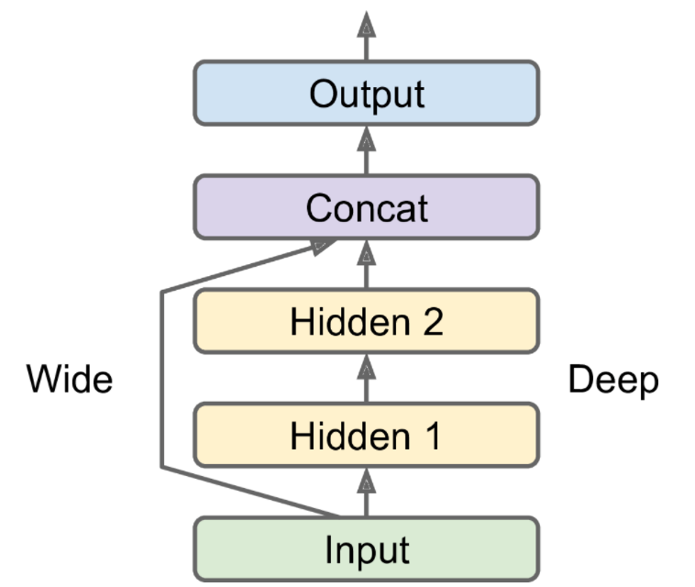
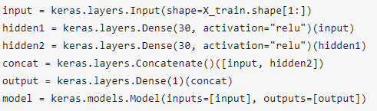
1. Keras Sequential
from keras.models import Sequential
from keras.layers import Dense, Dropout
model=Sequential()
Sequential is a linear stack of layers
Model that use sequential
LSTM, RNN
model = Sequential()
Example of non sequential, ResNet for CNN

Slide 49
2. Network Design
model.add(Dense(10, input_dim=16, activation='relu'))
model.add(Dropout(0.2))
model.add(Dense(8, activation="relu"))
model.add(Dropout(0.3))
#for 2 category (1,sigmoid), for n categories (n,softmax)
model.add(Dense(1, activation='sigmoid’))
Layer
# Neuron in the layer
Drop out
Activation function

Slide 50
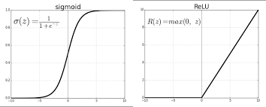
Sigmoid vs ReLU

Slide 51
3. Compile (Configuration)
model.compile(loss = 'binary_crossentropy', optimizer = 'Adamax', metrics = ['accuracy’])
#all parameters are needed
Loss function
Optimizer
Metrics
#https://www.tensorflow.org/guide/keras/train_and_evaluate

Slide 52
A. Losses
Important losses to know:
Mean squared error (Continuous)
Binary cross entropy (Discrete for 2 classes eg. Dog vs Cat)
Categorical cross entropy​​ (Discrete for >2 classes eg. Dog vs Cat vs Monkey)
 | Regressor (continuous) | Classifier(Categorical)
During Epoch (loss) | mse | Binary Cross entropy Categorical Cross-entropy
End of Epoch (metrics) | mse | Accuracy

Slide 53
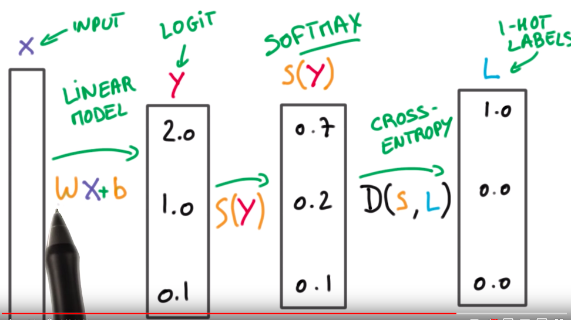
Cross Entropy and SoftMax

Slide 54
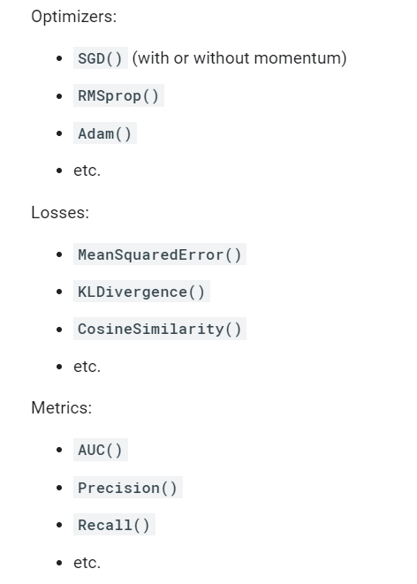

Loss, Optimizers and Metrics choices

Slide 55
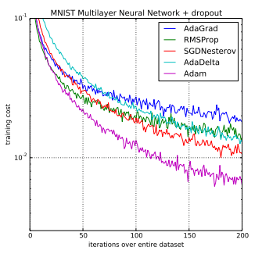
B. Optimizer
Loss – Type of error measurement (MSE) During the Epoch
Optimizer – Learning Rate (0.001)
Metrics – Accuracy, Specificity – End of each Epoch

Slide 56
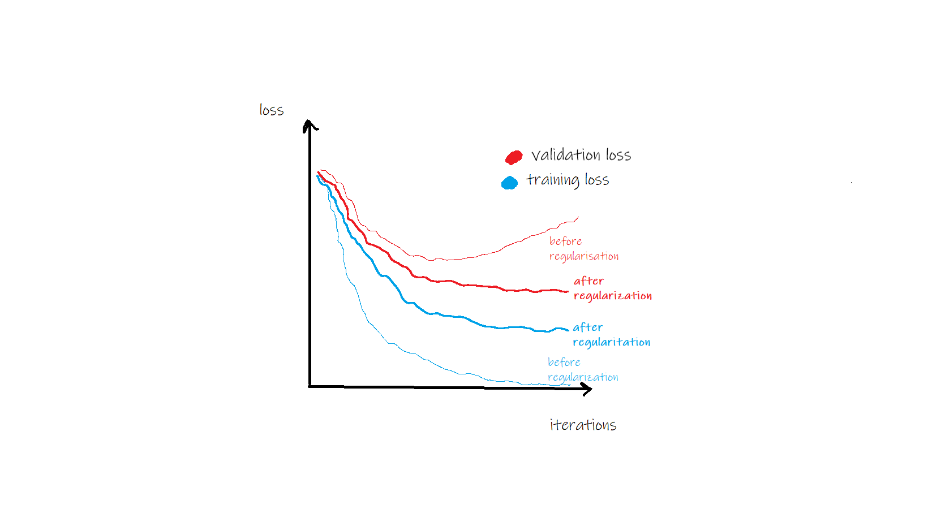
Optimizer - Generalization & Regularization
https://towardsdatascience.com/generalization-regularization-overfitting-bias-and-variance-in-machine-learning-aa942886b870

Slide 57
Optimizers
What are Optimizers?
Recall the goal of the neural network is to minimize the errors from the prediction and actual target across the dataset
Losses are the formula used to compute these error
Optimizer is HOW you want to UPDATE YOUR WEIGHTS. → minimize error

Slide 58
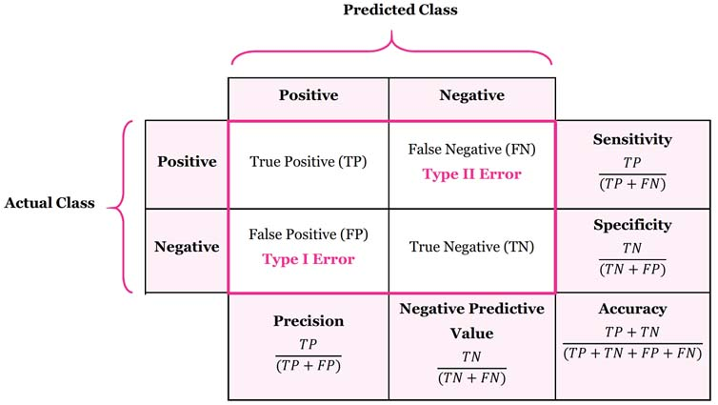
C - metrics
Categorical – Accuracy
Continuous - MSE

Slide 59
4. Fit
history = model.fit(X_train, Y_train, batch_size = 10, epochs=15, verbose=1)
Batch size is optional
import matplotlib.pyplot as plt
plt.plot(history.history['accuracy'])
#plt.plot(history.history['val_accuracy'])
plt.title('model accuracy')
plt.ylabel('accuracy')
plt.xlabel('epoch')
plt.legend(['train', 'val'], loc='upper left')
plt.show()
Epochs
Batch Size
plt.plot(history.history['loss'])
#plt.plot(history.history['val_loss'])
plt.title('model loss')
plt.ylabel('loss')
plt.xlabel('epoch')
plt.legend(['train', 'val'], loc='upper left')
plt.show()

Slide 60
5. Evaluate
model.evaluate(X_train, Y_train)
model.evaluate(X_test, Y_test)
import seaborn as sns
pred = model.predict_classes(X_test)
cm = confusion_matrix(Y_test, pred)
sns.heatmap(cm, annot=True)
#depends on number of classes
print((cm[0,0]+cm[1,1])/(sum(sum(cm))))
pred = model.predict(X_test)
For a multiclass classification use: pred = np.argmax(pred,axis=1)
For a binary class classification use :
pred = pred>0.5
pred = pred.astype('int32')

Slide 61
6 Prediction (Optional)
import numpy as np
from sklearn.metrics import confusion_matrix
pred=model.predict(X_train)
pred=np.where(pred>0.5,1,0)
cm=confusion_matrix(Y_train, pred)
print(cm)
accuracy=(cm[0,0]+cm[1,1])/sum(sum(cm))
print(accuracy)
pred=model.predict(X_test)
pred=np.where(pred>0.5,1,0)
cm=confusion_matrix(Y_test, pred)
print(cm)
accuracy=(cm[0,0]+cm[1,1])/sum(sum(cm))
print(accuracy)

Slide 62
Part III Examples

Slide 63
MLP in R: Exam Score Example

Slide 64
Rpackage neuralnet on Exam Score data
d = read.csv("C:/Users/Teoh Teik Teo/OneDrive - TSS Global Pte. Ltd/TT Library/AI Model/Neural Network/Exam Score.csv")
library(nnet)
model = nnet(d$Result ~ ., size = 3, data = d)
pred = predict(model)
pred = ifelse(pred>0.5,1,0)
cm = table(d$Result, pred)
print(cm)
accuracy=(cm[1,"0"]+cm[2,"1"])/sum(sum(cm))

Slide 65
Python
import pandas
d = pandas.read_csv("Exam Score.csv")
X = d.iloc[:, 1:3]
Y = d.iloc[:,3]
from sklearn.neural_network import MLPClassifier
model = MLPClassifier(solver='lbfgs', hidden_layer_sizes=(6, 2))
#Limited-memory Broyden–Fletcher–Goldfarb–Shanno
model.fit(X, Y)
pred = model.predict(X)
from sklearn.metrics import confusion_matrix
cm = confusion_matrix(Y, pred)
print(cm)
import joblib
joblib.dump(model, “Exam")

Slide 66
Front End HTML
<html>
<body>
<h1>Predict Exam Score</h1>
<form action="http://127.0.0.1:5000/" method="post">
<p>Please enter Hardworking : (0 to 1) </p>
<p><input type = "number" step="0.01" name = “hardworking"></p>
<p>Please enter Intelligence : (0 to 1) </p>
<p><input type = "number" step="0.01" name = “intelligence"></p>
<p><input type = "submit" value = "enter"></p>
</form>
{{result}}
</body>
</html>

Slide 67
Flask (Back End)
from flask import Flask
app = Flask(__name__)
from flask import request, render_template
import joblib
@app.route("/", methods = ["GET", "POST"])
def i():
if request.method == "POST":
hardworking = request.form.get(“hardworking")
intelligence = request.form.get(“intelligence")
print(hardworking, intelligence)
model = joblib.load(“Exam")
pred = model.predict([[float(hardworking), float(intelligence)]])
pred = pred[0]
print(pred)
s = "The predicted Exam Score is " + str(pred)
return(render_template("main.html", result = s))
else:
return(render_template("main.html", result = “Exam Result Prediction"))
Check port number netstat
#change port number
if __name__ == '__main__':
app.run(host="127.0.0.1", port=int("80"))
if __name__=="__main__":
app.run()

Slide 68
Virtual Environment (Optional)
1. Create virtual environment using cmd
python -m venv v09021930
v09021930\Scripts\activate.bat
2. pip install gunicorn, flask, joblib, sklearn
3. pip freeze > requirements.txt
4. Edit requirements.txt (if needed, usually no)

Slide 69
Example : Equity Data

Slide 70
Import data & Feature Selection
#replace word with number if needed
df['default'] = df["default"].replace(("Yes", "No"), (0,1))
import pandas as pd
df = pd.read_csv("Equity.csv")
df.isnull().any()
#pd.set_option("display.max_columns", None)
#pd.set_option("display.max_rows", None)
#feature selection
c = df.corr()
c = abs(c["Class"])
print(c[c>0.1].sort_values())
df.isnull().sum().sort_values() #df["cashConversionCycle"].isnull().sum()
df = df.loc[:, ["Class", "Dividend per Share", "10Y Net Income Growth (per Share)", "10Y Shareholders Equity Growth (per Share)", "EBIT", "Net Income", "Sector"]] #df.columns
d = df.isnull().any()
d[d==True]
d["EBIT"]
from sklearn.feature_selection import SelectKBest, f_regression
f = SelectKBest(score_func=f_regression, k=5)
f = f.fit(X, Y)
f = f.get_support()
f = X.columns[f]
f

Slide 71
Data Cleaning and Data Visualization
#remove not a number
for i in df.columns:
df1 = pd.to_numeric(df[i], errors='coerce')
df=df[df1.notnull()] #make it to null then remove null
print(df)
#Data Cleaning
df = df.dropna()
#pd.set_option("display.max_rows", 10)
#https://www.analyticsvidhya.com/blog/2021/07/how-to-perform-data-visualization-with-pandas/
df.describe()
df.hist(figsize=(10,10))
df.boxplot(figsize=(20,10)) #20 is width, 10 is length
import seaborn as sns
sns.heatmap(df.corr())
sns.catplot(data=df,x="Class", y="EBIT“, kind="violin") #kind=violin, bar, nothing means scatter

Slide 72
Matplotlib
#https://www.machinelearningplus.com/plots/top-50-matplotlib-visualizations-the-master-plots-python/
plt.scatter(df.Class, df["Dividend per Share"])
plt.scatter(df.Class, df["10Y Net Income Growth (per Share)"])
plt.xlabel(“Equity Class")
plt.xlabel(“Factors")
plt.title(“Equity Class vs Dividend & Net Income")
plt.legend(["Dividend", "Net Income"])
plt.show()

Slide 73
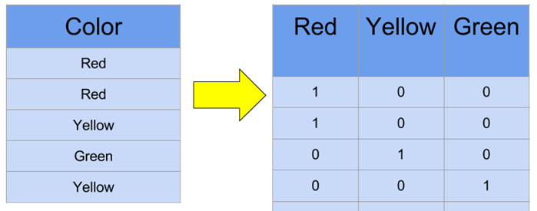
Dummy variables
df["Sector"].value_counts()
#X is categorical
dummy=pd.get_dummies(df["Sector"])
df=df.merge(dummy, left_index=True, right_index=True)
df=df.drop(columns = "Sector")

Slide 74
Remove Outlier
#remove outlier
import numpy as np
from scipy import stats
z = abs(stats.zscore(df))
f = (z < 4).all(axis=1) #3 is your choice, axis =1 means by columns, f is a flag
df = df[f]

Slide 75
Normalization
#normalization
from scipy import stats
import numpy as np
X["Net Income"]=stats.zscore(X["Net Income"])
X["EBIT"]=stats.zscore(X["EBIT"])
#normalization
from scipy import stats
import numpy as np
pd.set_option('display.max_rows', 10)
for i in X.columns:
X[i]=stats.zscore(X[i].astype(np.float))
print(X)

Slide 76
Balance the data
Y.value_counts() #check imbalance
#split X,Y
Y = df["Class"]
X = df.drop(columns="Class")
from sklearn.model_selection import train_test_split
X_train, X_test, Y_train, Y_test = train_test_split(X,Y)
from imblearn.over_sampling import SMOTE
Y_train.value_counts()
X_train, Y_train =SMOTE().fit_resample(X_train, Y_train)

Slide 77
Classifier
from sklearn.metrics import confusion_matrix
from sklearn import linear_model
model = linear_model.LogisticRegression()
model.fit(X_train,Y_train)
pred = model.predict(X_test)
cm = confusion_matrix(Y_test,pred)
print("accuracy", (cm[0,0]+cm[1,1])/(sum(sum(cm))))
from sklearn import tree
model = tree.DecisionTreeClassifier()
model.fit(X_train,Y_train)
pred = model.predict(X_test)
cm = confusion_matrix(Y_test,pred)
print("accuracy", (cm[0,0]+cm[1,1])/(sum(sum(cm))))

Slide 78
Classifier
from sklearn import ensemble
model = ensemble.RandomForestClassifier()
model.fit(X_train,Y_train)
pred = model.predict(X_test)
cm = confusion_matrix(Y_test,pred)
print("accuracy", (cm[0,0]+cm[1,1])/(sum(sum(cm))))
from sklearn import ensemble
model = ensemble.GradientBoostingClassifier()
model.fit(X_train,Y_train)
pred = model.predict(X_test)
cm = confusion_matrix(Y_test,pred)
print("accuracy", (cm[0,0]+cm[1,1])/(sum(sum(cm))))
from sklearn import neural_network
model = neural_network.MLPClassifier(max_iter=500)
model.fit(X_train,Y_train)
pred = model.predict(X_test)
cm = confusion_matrix(Y_test,pred)
print("accuracy", (cm[0,0]+cm[1,1])/(sum(sum(cm))))

Slide 79
Optional

Slide 80
NN on Regression

Slide 81
NN Regression on Treynor
import pandas as pd
df = pd.read_csv("C:/Users/Teoh Teik Teo/OneDrive - TSS Global Pte. Ltd/TT Library/AI Model/Data/Treynor.csv")
df.columns
df = df.loc[:,["fund_return_5years", "price_earnings_ratio", 'sector_communication_services', "price_book_ratio", "fund_treynor_ratio_5years"]]
X=df.iloc[:,0:4]
Y=df.iloc[:,4]
from scipy import stats
import numpy as np
X["return_rating"] = stats.zscore(X["return_rating"].astype(np.float))
from sklearn.model_selection import train_test_split
X_train, X_test, Y_train, Y_test = train_test_split(X,Y,random_state=123)

Slide 82
NN on continuous Y - Regression
from keras.models import Sequential
from keras.layers import Dense, Dropout
model = Sequential()
model.add(Dense(4, input_dim=4, activation='relu'))
model.add(Dropout(0.2))
model.add(Dense(4, activation='relu'))
model.add(Dropout(0.2))
model.add(Dense(1, activation='linear'))
model.summary()
model.compile(loss='mse', optimizer='adam', metrics=['mse'])
history = model.fit(X_train, Y_train, epochs=20, batch_size=1, verbose=1)
model.evaluate(X_train, Y_train)
model.evaluate(X_test,Y_test)
from numpy.random import seed
seed(123)
from tensorflow import random
random.set_seed(123)
#if not float, cast it
Y_train.dtypes
Y_train = Y_train.astype(float)
Y_test = Y_test.astype(float)

Slide 83
import matplotlib.pyplot as plt
plt.plot(history.history["mse"])
plt.title('model mse')
plt.ylabel(‘mse')
plt.xlabel('epoch')
plt.show()
r = model.evaluate(X_test,Y_test)
r[1] ** 0.5

Slide 84
Regression
from sklearn import linear_model
model = linear_model.LinearRegression()
model.fit(X_train, Y_train)
pred = model.predict(X_train)
from sklearn.metrics import mean_squared_error
print(mean_squared_error(pred, Y_train))
pred = model.predict(X_test)
print(mean_squared_error(pred, Y_test))

Slide 85
Decision Tree
from sklearn import tree
model = tree.DecisionTreeRegressor()
model.fit(X_train, Y_train)
pred = model.predict(X_train)
from sklearn.metrics import mean_squared_error
print(mean_squared_error(pred, Y_train))
pred = model.predict(X_test)
print(mean_squared_error(pred, Y_test))
from sklearn import ensemble
model = ensemble.RandomForestRegressor()
model.fit(X_train, Y_train)
pred = model.predict(X_train)
from sklearn.metrics import mean_squared_error
print(mean_squared_error(pred, Y_train))
pred = model.predict(X_test)
print(mean_squared_error(pred, Y_test))

Slide 86
Optional: CP optimum
# for optimization
X_train1, X_validate, Y_train1, Y_validate = train_test_split(X_train, Y_train, test_size=0.2)
for i in range(20):
print(i)
model = tree.DecisionTreeRegressor(max_depth = i+1)
model.fit(X_train1, Y_train1)
pred = model.predict(X_validate)
rmse = metrics.mean_squared_error(Y_validate, pred) ** 0.5
print(rmse)
print("===")
for i in range(100):
print(i)
model = tree.DecisionTreeRegressor(min_samples_split = i+2)
model.fit(X_train1, Y_train1)
pred = model.predict(X_validate)
rmse = metrics.mean_squared_error(Y_validate, pred) ** 0.5
print(rmse)

Slide 87
Other Neural Network
RNN
LSTM
CNN
GAN

Slide 88
Reading Material (Optional)
Shwartz https://www.dropbox.com/s/ed9s6zyrtjgc7dk/Shwartz.pdf?dl=0
Interview Question: https://www.simplilearn.com/tutorials/deep-learning-tutorial/deep-learning-interview-questions
Video
https://www.youtube.com/watch?v=aircAruvnKk&t=585s
https://www.youtube.com/watch?v=1BZm5RAljn0

Slide 89
Summary
Learn how to
How to define neural network in Keras.
How to compile a Keras model using the efficient numerical backend.
How to train a model on data.
How to evaluate a model on data.
How to predict the test data.

Slide 90
Thank you

